Slide 1





GIT Training for IT Professionals
Kristof Werling KwerlingIT GmbH 1 Sept 2023

Slide 2




Who am I
Kristof Werling
31 years of experience at HP: DevOp, Developer, Architect
Started KwerlingIT GmbH
Focus: IT / Cyber Security
Security Audits, IT consulting, Trainings, Software creation
KwerlingIT GmbH
kristof.werling@kwerlingit.com
https://www.linkedin.com/in/kristof-werling/
https://www.kwerlingit.com

Slide 3
Table of Content
Disclaimer
Short Command Line Introduction
Introduction into GIT
Common GIT commands
Working with Branches
Remote repositories
Best practices
GIT Workflows
Project & Issue Management

Slide 4
Disclaimer
The presentation was created on a MS-Windows-based Computer
Screen-shots are made, and explanation are based in the MS-Windows environment
Wherever the author is aware of a significant difference between MS-Windows and Macintosh operating environments the slides will point out these differences.
The author uses Github.com for all demonstration purposes

Slide 5
Short command line introduction
Here you learn how to reach the command line and how to navigate in the Directory tree of your filesystem.

Slide 6
Accessing the command line
MS-Windows
Macintosh
Open the "Start" menu.
Type "cmd" or "Command Prompt" in the search bar and press Enter.
This opens the Command Prompt window in your user directory.
Open the "Applications" folder.
Go to the "Utilities" folder.
Launch the "Terminal" application.
This provides the shell command line in your home directory.

Slide 7
Show content of a directory
MS-Windows
Macintosh
Type “dir“ and press Enter
Type “ls“ and press Enter
In order to get the same level of detail as with the “dir“ command type “ls -l“

Slide 8
Show content of a directory
MS-Windows
Macintosh
There are two special directory names: "." and ".."
They exist in every directory and are needed for the OS to finds its way in the filetree.
How to make use of them is shown in the explanation for relative paths.
Same as for MS-Windows

Slide 9
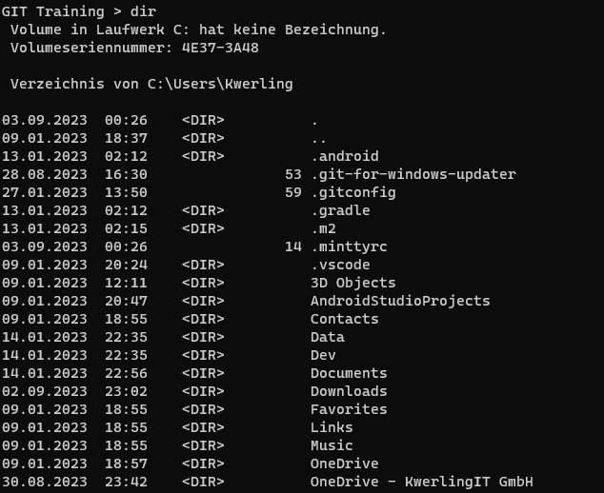
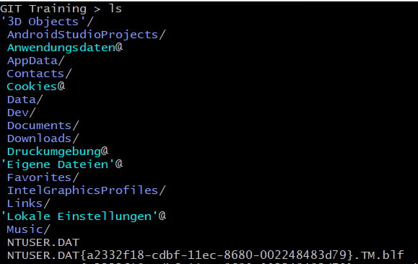
Show content of a directory
MS-Windows
Macintosh

Slide 10
Where am I in the directory Tree
MS-Windows
Macintosh
Type "cd" and press Enter
In MS-Windows the directory names are separated by a backslash ("\")
In MS-Windows Drives exist. Each drive has a single letter followed by a colon as name ("c:", "f:"). Each drive has its own root directory.
Type "pwd" and press Enter
In Unix and macOS the directory names are separated by a slash ("/")
Unix and macOS only have one root directory and the complete directory tree us reachable from there.

Slide 11
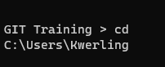
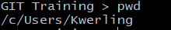
Where am I in the directory Tree
MS-Windows
Macintosh

Slide 12
Moving in the Filesystem Absolute Path
An absolute path specifies the exact location of a file or directory from the file system's root directory (the top-level directory).
It begins with the root directory's name (e.g., C:\ in Windows or / in Unix-like systems) and provides a complete path to the target file or directory.
Absolute paths are not dependent on the current working directory and can be used to locate a file or directory from anywhere in the file system.
Examples of absolute paths:
Windows: C:\Users\YourUsername\Documents\file.txt
macOS/Linux: /home/YourUsername/Documents/file.txt

Slide 13
Moving in the Filesystem Relative Path
A relative path starts either with a directory name or one or two dots ("." or ".."). "." (dot) represents the current directory, and ".." (dot-dot) represents the parent directory.
A relative path specifies the location of a file or directory with respect to the current working directory.
Examples (in Unix notation with "/"):
Reports/file1.txt: file "file1.txt" in the subdirectory " Reports " of the current directory
../ Reports /file1.txt: file "file1.txt" in the subdirectory " Reports " of the parent directory

Slide 14
Moving in the Filesystem
MS-Windows
Macintosh
Type "cd <directory>", where <directory> is the directory, you want to change to, and then press Enter.
Directories can be named absolute or relative.
Same as for MS-Windows

Slide 15
Creating new directories
MS-Windows
Macintosh
Type "mkdir <directory>", where <directory> is the directory you want to create, and then press Enter.
Directories can be named absolute or relative.
"mkdir" can be abbreviated as "md"
Same as for MS-Windows, but the abbreviation of "md does not exist.

Slide 16
Remove / Delete A directories
MS-Windows
Macintosh
Type "rmdir <directory>", where <directory> is the directory, you want to delete, and then press Enter.
Directories can be named absolute or relative.
The directory must be empty.
"mkdir" can be abbreviated as "rd"
Same as for MS-Windows, but the abbreviation of "rd does not exist.

Slide 17
Exercises
MS-Windows
Macintosh
Open a new Command Prompt window
Switch to the "AppData\Local\Temp" directory
The content of the directory will look different for each user, as it is used by the OS and many applications
Open a new Terminal window
Switch to the "/tmp" directory
The content of the directory will look different for each user, as it is used by the OS and many applications

Slide 18
Exercises
MS-Windows and Macintosh
Build the directories and subdirectories as shown on the right-hand-side.
.
└─ Folder 1 │ └─ Folder 1.1 │ └─ Folder 1.2 └─ Folder 2 └─ Folder 2.1 └─ Folder 2.2

Slide 19
Exercises
MS-Windows and Macintosh
Switch to directory "Folder 2"
Delete directory "Folder 2.2"
Goto to the parent directory
Delete "Folder 2" --- What happens and how to delete the folder?
Do the same for "Folder 1"
Try to use absolute and relative path names for the directories you work with

Slide 20
Introduction into GIT
How to work with Github, Gitlab, Bitbucket and many other providers of GIT repositories

Slide 21
Technical Environment
Git Repository Service Provider: Github
IDE: IntelliJ
Command line tools: standard git programs

Slide 22
Table of Content
Why a VCS?
Basic GIT concepts
Installation of GIT
Local configuration
Creation of a repository
Adding files / directories to a repository
Working with branches
Remote repositories
Tags in GIT
Git workflows
Best practises

Slide 23
Why a VCS?
Data Protection (prevent data loss / corruption)
Collaboration (Multiple users can work on the same project in a controlled way)
Auditing (tracking of changes on each file)

Slide 24
Basic GIT concepts
Repository (local or remote): Store for your files and their version history
Commit: A new version of files stored to the repository version history.
Branch: A forked specific version of the files in the repository
Merge: Combining changes of one branch into another

Slide 25
Installation of GIT
MS-Windows
Macintosh
Windows requires an installation
There is a fair chance, that GIT is already installed on your machine.
Verify it by opening a Terminal and type "git –version" followed by Enter
If it is not installed see next slide

Slide 26
Installation of Git
Goto: https://git-scm.com/downloads
Depending on your OS follow the instructions on the page.
Make sure that the git-command can be used from the command line
There are also GUI Clients available from that page. No need to install any of them.

Slide 27
Local configuration
It is necessary to configure your real name and email address:
On the command line enter this: git config --global user.name “<<Real name of user>>“ git config --global user.email “somebody@computer.com“

Slide 28
Local configuration
There are 3 levels of configuration hierarchy:
Level | Explanation
system | Taken, when there is no global or local configuration
global | Taken, when there is no local configuration
local | Taken, if it exists

Slide 29
Local configuration
If wished, a standard editor (or IDE) can be configured for viewing or editing text and source files: git config --global core.editor "idea"

Slide 30
Creation of a repository
"git init" create a new git repository in the directory it is executed in
If there are files or directories in this directory, then these will not be added to the repository automatically.
After execution there will be a new directory by the name of ".git". It stores the content of the repository as well as the needed information for the repository management.

Slide 31
Excercise: Create a new local repository
Open a Terminal window
Goto an empty directory
Verify that it is empty
Run the "git init" command
Verify that the ".git" directory exists
Have a look into that directory

Slide 32
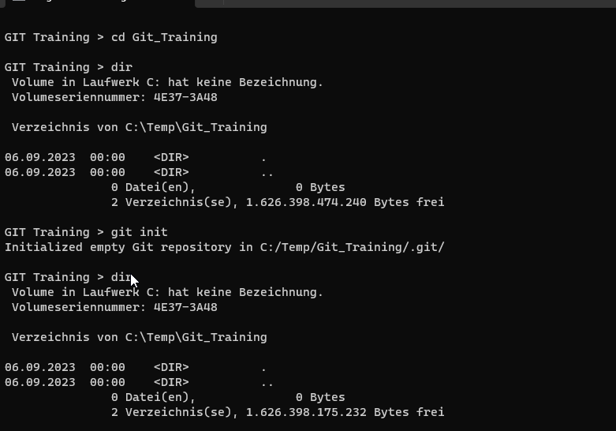
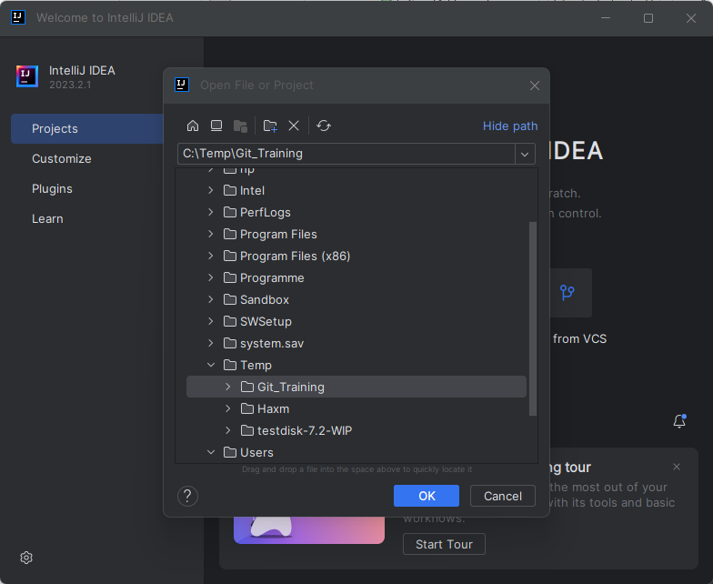
Excercise: Create a new local repository
Command Prompt
IntelliJ

Slide 33
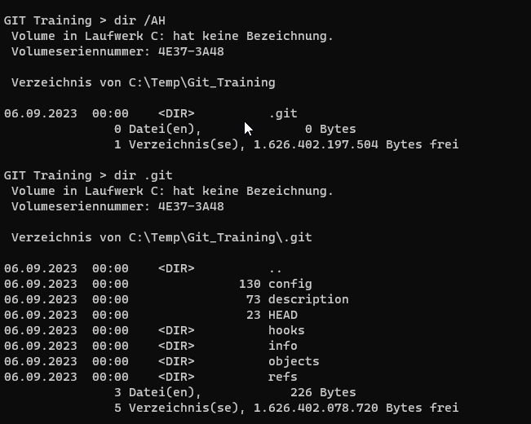
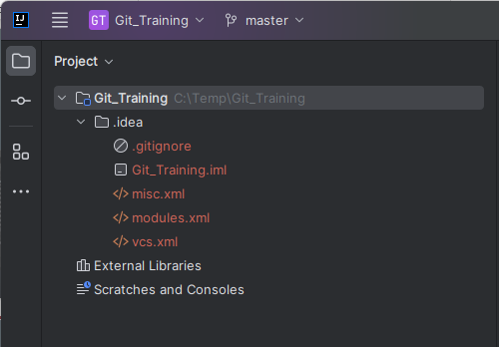
Excercise: Create a new local repository
Command Prompt
IntelliJ

Slide 34
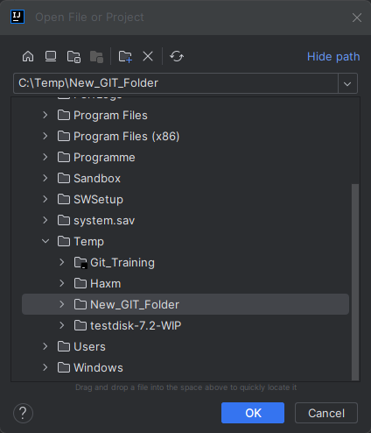
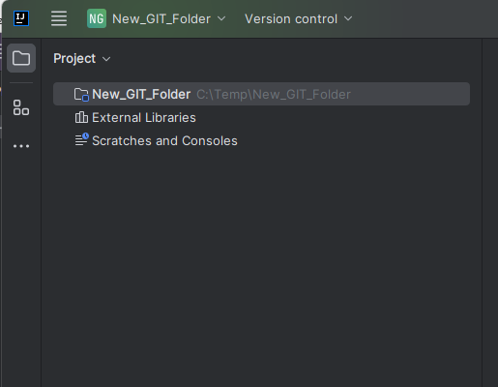
Excercise: Create a new local repository
IntelliJ
IntelliJ

Slide 35
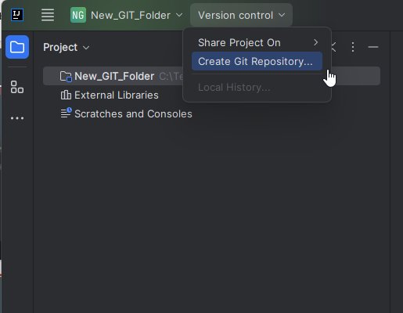
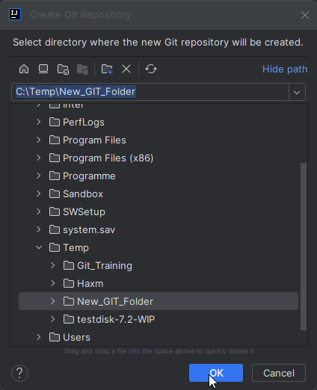
Excercise: Create a new local repository
IntelliJ
IntelliJ

Slide 36
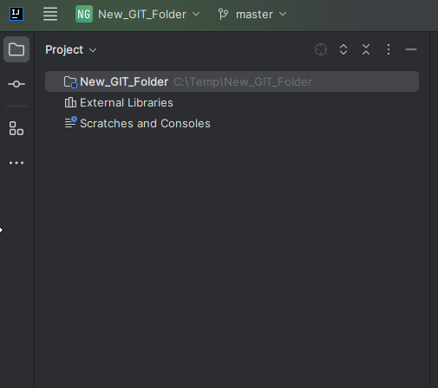
Excercise: Create a new local repository
IntelliJ

Slide 37
Adding files / directories to a repository
Adding files / directories to a repository is a 2 phase process:
Adding to a staging area
Committing to the repository
Working directory
add
rm
reset
Staging area
restore
commit
Repository

Slide 38
Adding files / directories to a repository
Here are the command you'll need in that context:
Command | Explanation
git status | Shows changes since last commit and the content of the staging area
git add <<file/dir . --all>> | Adds to the staging area if content is newer than last commit
git commit –m "Commit comment" | Adds files from staging into the repository
git reset HEAD <<file/dir name>> | Remove file/dir from staging
git rm <<file>> | -r <<dir>> | Remove file/dir and add it to staging
git restore <<file/dir>> | Restore file/dir from the repository
git log | Shows the commit history

Slide 39
Adding files / directories to a repository
What | .gitignore | .git/info/exclude
Location | Every directory in the project can have one, but mostly found in the root directory. | Only one file on the above shown location in the project.
Function | Contains the information on what to ignore for /exclude from commits as of the directory it is in. | Contains the information on what to ingnore for / exclude from commits for the project.
Format | # Start a comment line * Stands for any character but a slash / Separates directories <<file/dir>> Matches the file or dir, absolute or relative **/ Matches any directory + subdirectories /** Matches all files and sub-dirs in a dir [a-zA-Z0-9] Matches a range(s) of characters

Slide 40
Adding files / directories to a repository
Pattern in .gitignore | Explanation
node_modules | Ignore the node_modules dir (or file)
node_modules/ | Ignore the content of the dir, but not the dir itself
# All bin files | Comment, has no consequence
/*/temp | Ignore the temp dir in each of the subdirs of the dir the .gitignore is in (1 level)
/**/readme | Ignore the file readme in any of the subdirs of the dir the .gitignore file is in
d/**/k | Matches d/k, d/x/k, d/x/y/k, and so on

Slide 41
Exercise: Adding to the repository (Try to do the exercise on the command line and, if possible, in intelliJ)
Goto an empty directory, where you created a new GIT repositor and which you already opened as a project in IntelliJ.
Look at the GIT status
You should see an .idea directory, which is not comitted yet
Add the directory to staging
Look at the GIT status
Remove the directory and its files from staging again
Look at the GIT status

Slide 42
Exercise: Adding to the repository (Try to do the exercise on the command line and, if possible, in intelliJ)
Make sure that the .idea directory is never considered for staging again
Look at the GIT status
Use IntelliJ to create file1.txt with this content: This is the first file I am going to check in
Save the file
Look at the GIT status
Add the file to staging
Look at the GIT status

Slide 43
Exercise: Adding to the repository (Try to do the exercise on the command line and, if possible, in intelliJ)
Commit to the repository
Look at the GIT status
Add a second line to file1.txt and save it: Here is a modification
Look at the GIT status
Add all modified files to staging and commit them to the repository
Look at the GIT status

Slide 44
Exercise: Adding to the repository (Try to do the exercise on the command line and, if possible, in intelliJ)
Use the OS GUI to delete file1.txt from the directory
Look at the GIT status
Get the latest version of the file from the repository
Look at the GIT status
Have a look at the commit history

Slide 45
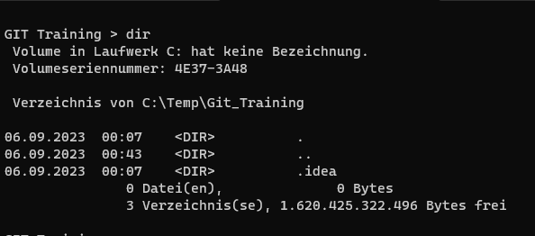
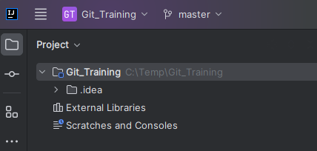
Exercise: Adding to the repository
Command Prompt
IntelliJ

Slide 46
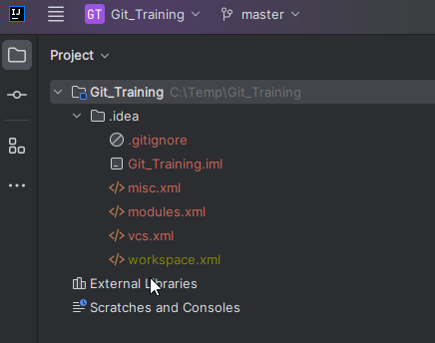
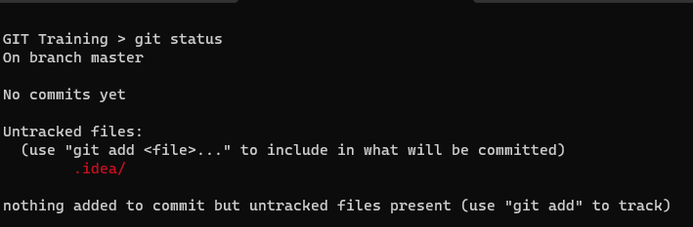
Exercise: Adding to the repository
Command Prompt
IntelliJ

Slide 47
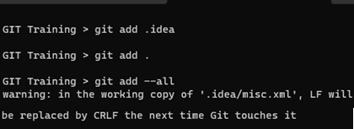
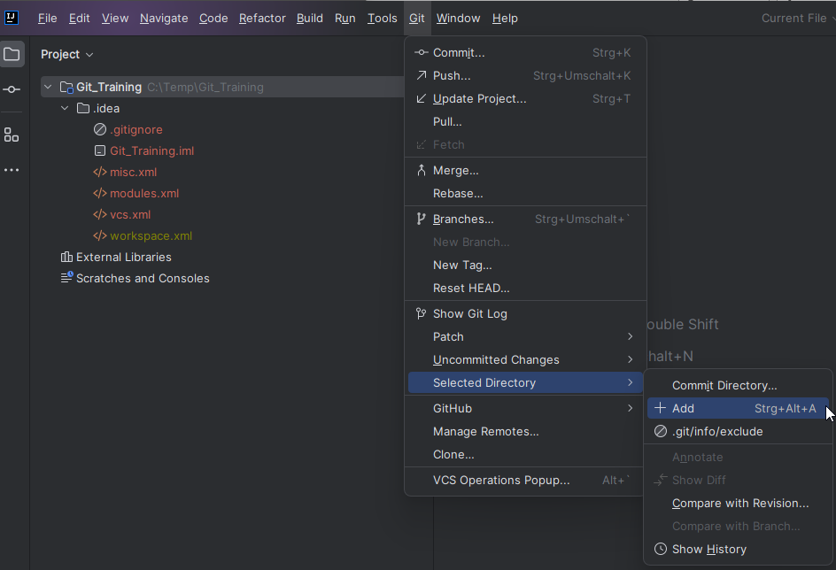
Exercise: Adding to the repository
Command Prompt
IntelliJ

Slide 48
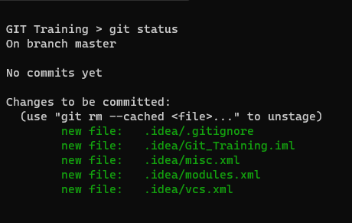
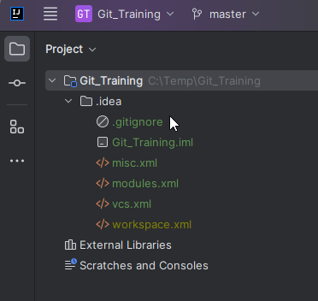
Exercise: Adding to the repository
Command Prompt
IntelliJ

Slide 49
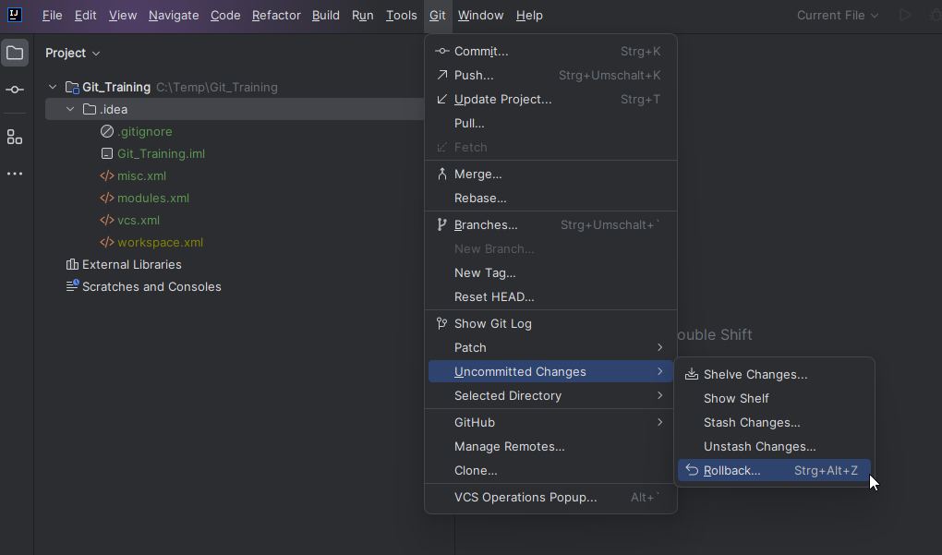
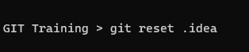
Exercise: Adding to the repository
Command Prompt
IntelliJ

Slide 50
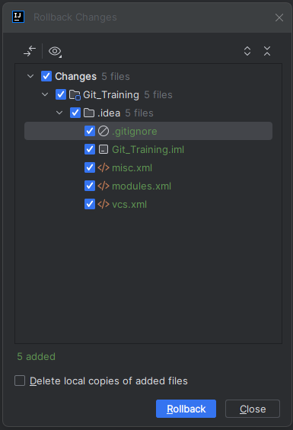
Exercise: Adding to the repository
Command Prompt
IntelliJ

Slide 51
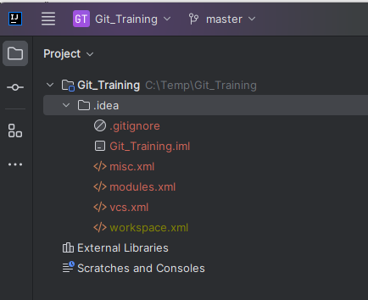
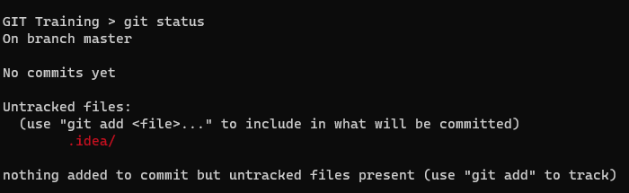
Exercise: Adding to the repository
Command Prompt
IntelliJ

Slide 52
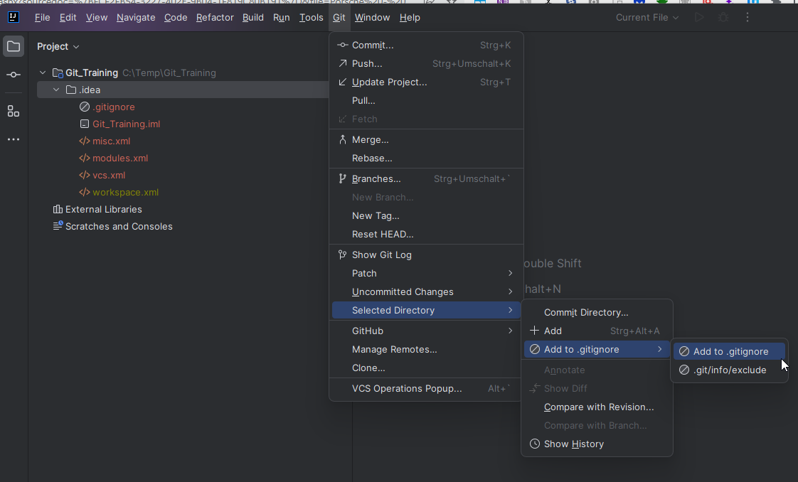
Exercise: Adding to the repository
Command Prompt
IntelliJ

Slide 53
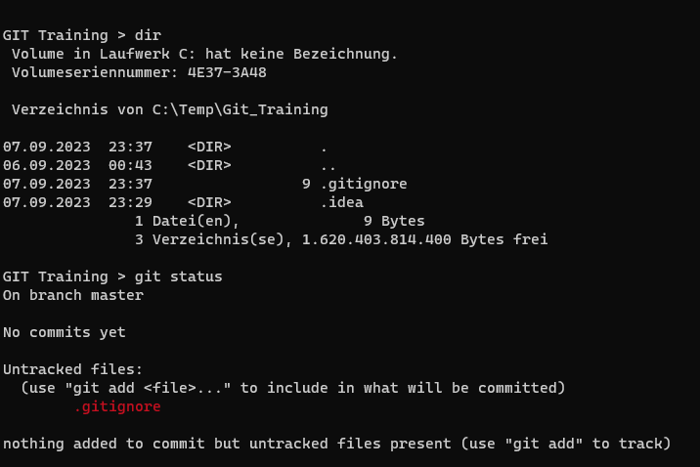
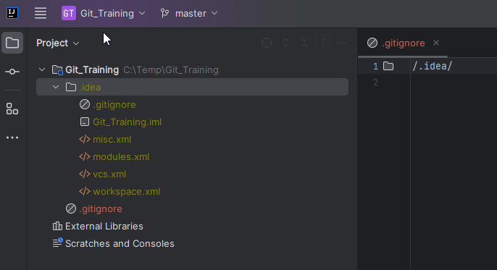
Exercise: Adding to the repository
Command Prompt
IntelliJ

Slide 54
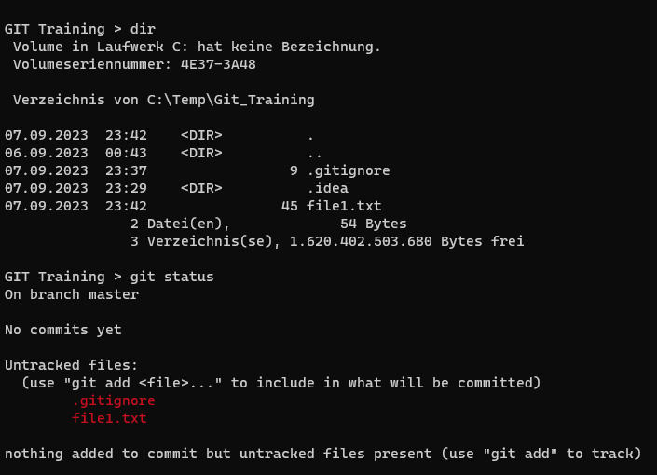
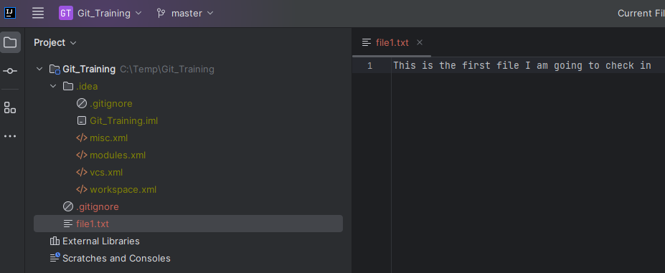
Exercise: Adding to the repository
Command Prompt
IntelliJ

Slide 55
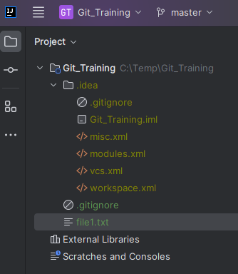
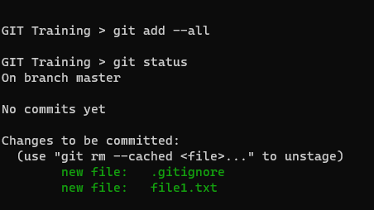
Exercise: Adding to the repository
Command Prompt
IntelliJ

Slide 56
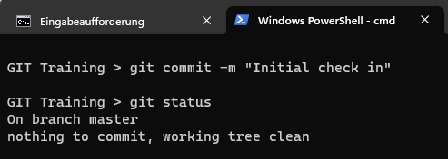
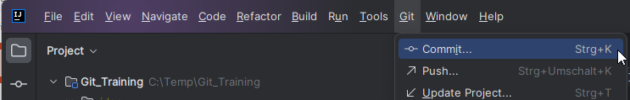
Exercise: Adding to the repository
Command Prompt
IntelliJ

Slide 57
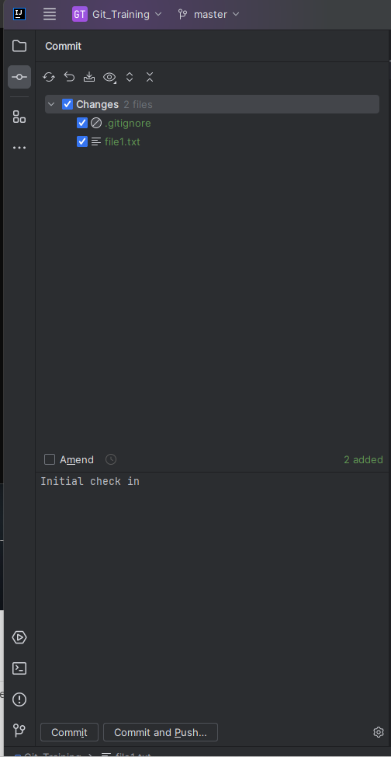
Exercise: Adding to the repository
Command Prompt
IntelliJ

Slide 58
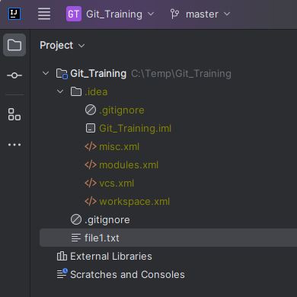
Exercise: Adding to the repository
Command Prompt
IntelliJ

Slide 59
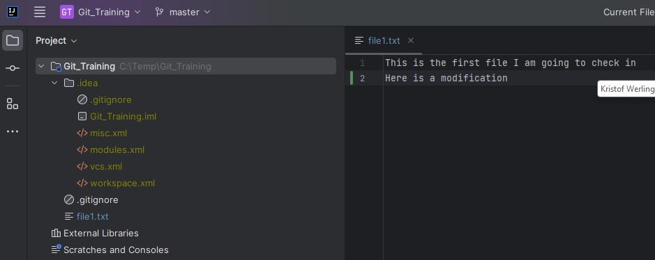
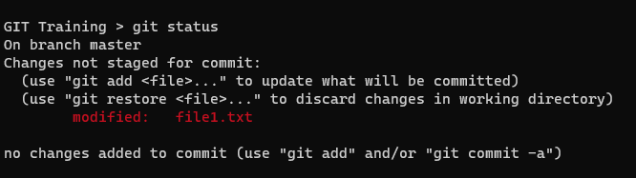
Exercise: Adding to the repository
Command Prompt
IntelliJ

Slide 60
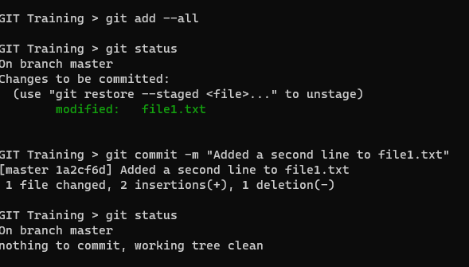
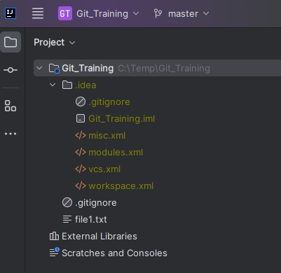
Exercise: Adding to the repository
Command Prompt
IntelliJ

Slide 61
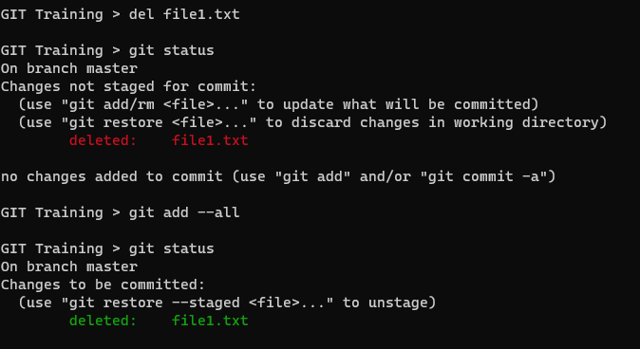
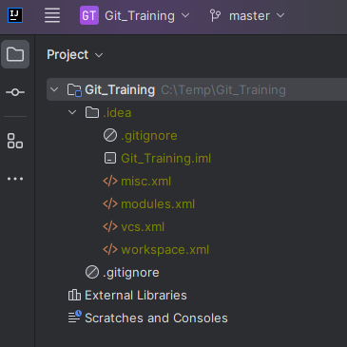
Exercise: Adding to the repository
Command Prompt
IntelliJ

Slide 62
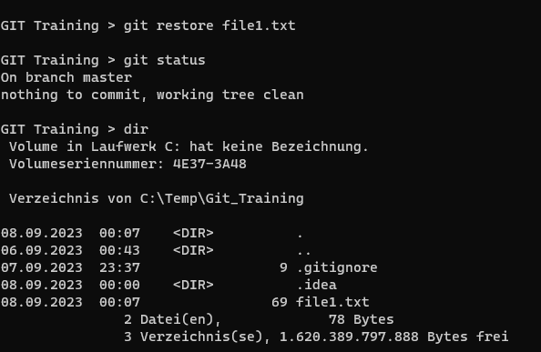
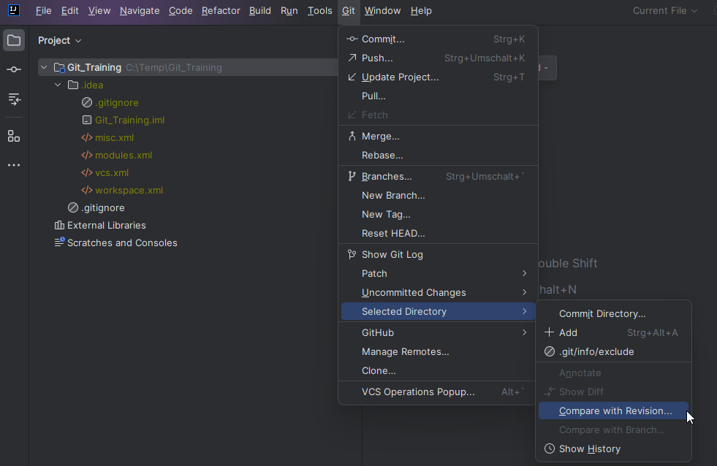
Exercise: Adding to the repository
Command Prompt
IntelliJ

Slide 63
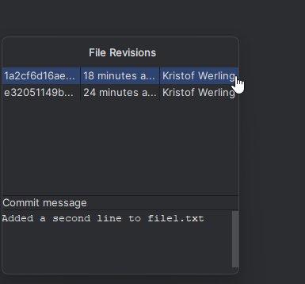
Exercise: Adding to the repository
Command Prompt
IntelliJ

Slide 64
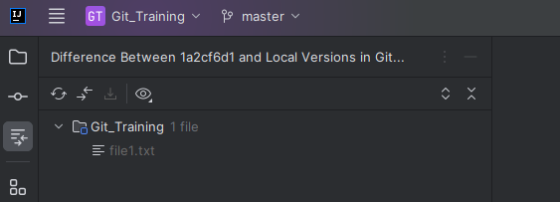
Exercise: Adding to the repository
Command Prompt
IntelliJ

Slide 65
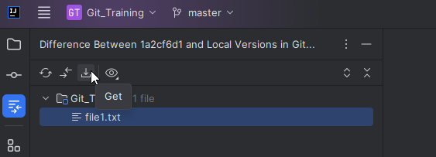
Exercise: Adding to the repository
Command Prompt
IntelliJ

Slide 66
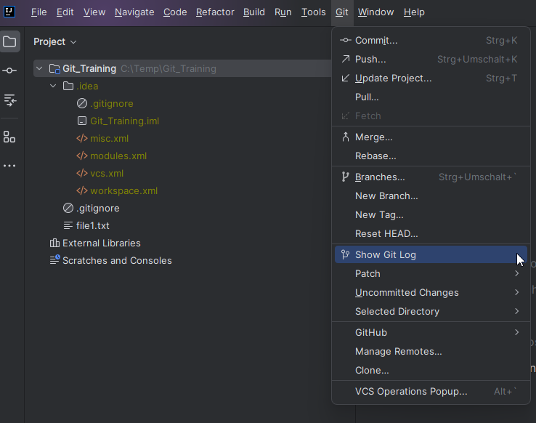
Exercise: Adding to the repository
Command Prompt
IntelliJ

Slide 67
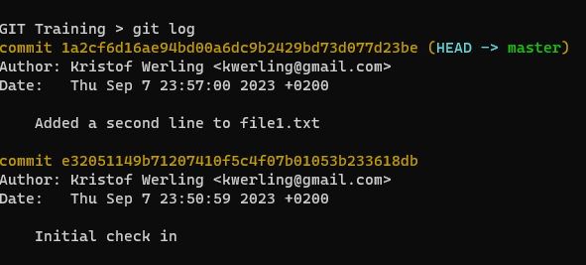

Exercise: Adding to the repository
Command Prompt
IntelliJ

Slide 68
Working with Branches
Bug #5d8
Feature #4e
master
Bug #3a2
Legend |  | Branch name |  |  | Same branch
 |  |  |  |  | New branch
 |  | Commit |  |  | Merge
master

Slide 69
Working with Branches
Here are the command you'll need in that context:
Command | Explanation
git branch <<branch>> | Creates a new branch
git switch <<branch>> | Switch to another branch
git merge <<branch>> | Merges the <<branch>> branch into the active one
git mergetool | UI to resolve merge conflicts
git stash | Saves changes to prevent a commit
git stash apply | Re-apply the saved changes
git stash list | drop | List all saved changes | removes a saved change
git branch –[dD] <<branch>> | Deletes branch (-D) or only when merged (-d)

Slide 70
Working with Branches
Merge conflicts:
They occur when merging overlapping changes from two branches
One can resolve them manually (with an editor) or use the "git mergetool" command, IntelliJ, or one of the many other available tool
Once resolved the modified file needs to be committed to the repository
The modifications to the file(s) only happen in the actual branch.

Slide 71
Exercise: Working with Branches
Create a branch called "feature"
Switch to it
Create a file, called "mergefile.txt" and enter the following text: This is a change to the feature branch
Commit the changes to the repository
Switch back to the master branch

Slide 72
Exercise: Working with Branches
Create a file, called "mergefile.txt" and enter the following text: This is a change to the master branch
Commit the changes to the repository
Merge the "feature" branch into the "master" branch
Resolve the merge conflict.
Delete the "feature" branch

Slide 73


Exercise: Working with Branches
Command Prompt
IntelliJ

Slide 74

Exercise: Working with Branches
Command Prompt
IntelliJ

Slide 75

Exercise: Working with Branches
Command Prompt
IntelliJ

Slide 76

Exercise: Working with Branches
Command Prompt
IntelliJ

Slide 77


Exercise: Working with Branches
Command Prompt
IntelliJ

Slide 78


Exercise: Working with Branches
Command Prompt
IntelliJ

Slide 79

Exercise: Working with Branches
Command Prompt
IntelliJ

Slide 80

Exercise: Working with Branches
Command Prompt
IntelliJ

Slide 81

Exercise: Working with Branches
Command Prompt
IntelliJ

Slide 82


Exercise: Working with Branches
Command Prompt
IntelliJ

Slide 83

Exercise: Working with Branches
Command Prompt
IntelliJ

Slide 84


Exercise: Working with Branches
Command Prompt
IntelliJ

Slide 85


Exercise: Working with Branches
Command Prompt
IntelliJ

Slide 86


Exercise: Working with Branches
Command Prompt
IntelliJ

Slide 87


Exercise: Working with Branches
Command Prompt
IntelliJ

Slide 88

Exercise: Working with Branches
Command Prompt
IntelliJ

Slide 89
Working with Branches
There is no predominant branch in GIT. This is decided by convention.
The GIT tool uses "master" as the default branch
Because of the connection of the word master with racism, GITHUB renamed their default branch into "main"
Theoretically one could have any other branch name as the default one.

Slide 90

Remote repositories
Explanation
Usual setup of remote and local repositories
When synced the three repositories contain the same information
Usually, the remote repository is considered to be the main one
User A & B sync from remote, but not between themselves
Repository Remote Github
Repository Local User A
//
Repository Local User B

Slide 91
Remote repositories GITHUB remote repository setup
If not already done: Sign up @ github.com
Sign into your account
Create a repository for the upcoming exercises

Slide 92

Remote repositories GITHUB remote repository setup
Sign up
&
Sign in

Slide 93

Remote repositories GITHUB remote repository setup
Create a new repository

Slide 94

Remote repositories GITHUB remote repository setup
Give it a name
Explain, what the repository is for
Decide, it the repository is public or private
Do you want a Readme.md file?
Get a head start on .gitignore for your dev env
Choose a license, important for public repositories
Set the default branch name
Create the repository

Slide 95
Remote repositories GITHUB remote repository setup
Github uses the default branch "main"
Our repository uses the default branch "master"
This can be taken care of in the setup of the remote repository in our local repository

Slide 96


Remote repositories GITHUB remote repository setup

Slide 97
Remote repositories
A remote repository is a associated with one (or many) local repositories.
The remote repository does not configure the local ones, it is vice versa.
The access to a remote repository can be managed and by that restricted to individual users. Write or read access can also be configured. There is no finer granularity than the individual remote repository.
GitHub, GitLab, BitBucket, Google, AWS, and other platforms provide remote repository services for GIT.

Slide 98
Remote repositories
Here are the command you'll need in that context:
Command |  | Explanation
git remote | add <<name>> <<url>> | Adds a new remote
 | -v | Lists info on remotes
 | remove <<name>> | Removes a remote
 | set-head <<name>> | Sets the default branch
git push |  | Push local changes to remote
git pull ( == git fetch + git merge) |  | Sync up with remote
git fetch |  | Syncs remote into local tracking branches
git merge |  | Merges tracking branches with local repository

Slide 99
Remote repositories
"origin" is the default name for the remote repository
Name it like that to save some typing
A branch can have many remote repositories associated with it

Slide 100
Remote repositories
Use "git clone << url >>" to copy the content of a remote repository to a local one
As of then the usual comments "git add", "git commit", and "git push" can be used without any additional configuration.

Slide 101
Exercise: Remote repositories
Add your GitHub remote repository as "origin" to the local repository
Push your local directory to "origin"
On GitHub: Switch to the master branch
On GitHub: Simulate another user working with the repository by adding the line "Changed by someone else" to file1.txt and commit
Local: Add the line "Local change" to the file mergefile.tx

Slide 102
Exercise: Remote repositories
Commit the change
Push it to "origin"

Slide 103


Exercise: Remote repositories
Command Prompt
IntelliJ

Slide 104

Exercise: Remote repositories
Command Prompt
IntelliJ

Slide 105

Exercise: Remote repositories
Command Prompt
IntelliJ

Slide 106

Exercise: Remote repositories
Command Prompt
IntelliJ

Slide 107


Exercise: Remote repositories
Command Prompt
IntelliJ

Slide 108

Exercise: Remote repositories
Command Prompt
IntelliJ

Slide 109


Exercise: Remote repositories
Command Prompt
GitHub

Slide 110

Exercise: Remote repositories
Command Prompt
GitHub (after refresh)

Slide 111

Exercise: Remote repositories
Command Prompt
GitHub

Slide 112

Exercise: Remote repositories
Command Prompt
GitHub

Slide 113

Exercise: Remote repositories
Command Prompt
GitHub

Slide 114

Exercise: Remote repositories
Command Prompt
GitHub

Slide 115

Exercise: Remote repositories
Command Prompt
GitHub

Slide 116

Exercise: Remote repositories
Command Prompt
GitHub

Slide 117


Exercise: Remote repositories
Command Prompt
Intellij

Slide 118


Exercise: Remote repositories
Command Prompt
Intellij

Slide 119


Exercise: Remote repositories
Command Prompt
Intellij

Slide 120


Exercise: Remote repositories
Command Prompt
Intellij

Slide 121

Exercise: Remote repositories
Command Prompt
Intellij

Slide 122

Exercise: Remote repositories
Command Prompt
Intellij

Slide 123
Exercise: Remote repositories
Command Prompt
GitHub

Slide 124
Tags in git
Tags are used to mark specific points in the project's history, such as a release, a milestone, or any other important point.
A commit can have multiple tags or none at all
Use "git tag << tag >> << commit hash>>" to tag
Use "git log" to find the commit hash
"git show << commit hash >>" provides details on a commit

Slide 125
Git Workflows
There are many different workflows used with GIT
The following is a summary of the more widely used ones

Slide 126
Git Workflows
In Trunk-based developers merge small, frequent updates to a core “trunk” or main branch.
Best practice:
Develop in small batches
Usage of Feature flags
Implement comprehensive automated testing
Merge branches to the trunk at least once a day

Slide 127
Git Workflows
Gitflow: The Gitflow consists of two main branches:
master branch
develop branch
The master branch is the stable branch that contains the released code. The develop branch is the development branch that contains the latest code changes.

Slide 128
Git Workflows
Feature branching: The feature branching workflow is a simple workflow that is often used by small teams.
It consists of creating a new branch for each feature that is being developed.
Once the feature is complete, the branch is merged into the master branch.

Slide 129
Git Workflows
Forking workflow: The forking workflow is a workflow that is often used for open source projects.
It consists of creating a fork of the project repository into your own account.
You then change the fork and submit pull requests to the main repository.

Slide 130
Git: Best practices
Use a consistent naming convention for your branches. This will make it easier to identify and track your branches.
Use a branching strategy that works for your team. There are many different branching strategies, so find one that works well for your team.
Commit frequently and concisely. This will make it easier to track your changes and revert to previous versions if needed. This will help you to keep your working tree clean and organized.
Write meaningful commit messages. Your commit messages should be clear and concise, and they should explain the changes that you have made.
Use a consistent naming convention for your tags. Make use of tags often.

Slide 131
Appendices

Slide 132
Appendix A: Installation of IntelliJ

Slide 133

Download & Install
Goto: https://www.jetbrains.com/edu-products/download/#section=idea
Download this:
Run the executable. There is no need to install Java first.

Slide 134

Download & Install
Start it and click on "Learn" (left-hand-side menu)m then click on the "Enable Access" button and you are good to go.

Slide 135
Appendix B: Options in IntelliJ

Slide 136








Reach the options Menu

